Slide 1
HTML + CSS
WEBD 120 - Web Programming 1
Link to slides: http://bit.ly/humber-web-1
Ryan Christiani
Week 1

Slide 2
A Series of Tubes
In 1989 Sir Tim Berners-Lee is working at CERN, he began working on a way to share research documents. This eventually led to the creation of the World Wide Web.
In 1994 he founded the W3C (World Wide Web Consortium). The W3C is a group that defines the specifications and standards for the web.
/* A quick note, the World Wide Web and Internet are different things. The Internet is the physical connections of computers, the World Wide Web is the system in which linked documents are accessed via the Internet */

Slide 3
What is HTML + CSS
HTML is the structure and semantics of a document. It is a markup language, if you want to display an image on your web page you would use a <img> HTML tag.
CSS is used to describe the look and feel of a document. It is a style sheet language. CSS stands for Cascading Style Sheets. If you want to increase the size of the text on your page you would use font-size: 18px CSS property.

Slide 4
Front-End / Client-Side
HTML is the structure of a page, it is like the scaffolding of a house.
CSS is the brick colour and paint. What kind of roof, siding, or door colour does the house have.
Javascript is the electricity and appliances for the building. It is a programming language used to control the interactions of the page.
All of these together are what you call Front-End or Client-Side Development.

Slide 5
Different types of HTML.
There are a few different names you might have heard about.
HTML, XHTML, and everyones favourite. HTML5.
HTML - Hypertext Markup Language
XHTML - Extensible HyperText Markup Language
HTML5 - Hypertext Markup Language version 5, this is the current working specification of the HTML language.

Slide 6
Building your first page
There are two things you need to get started. A browser and a text editor.
A modern browser like Chrome or Firefox are great for development. They come full of extremely useful tools for debugging.
A text editor like Sublime Text is a simple program that your write your own programs or web pages.

Slide 7
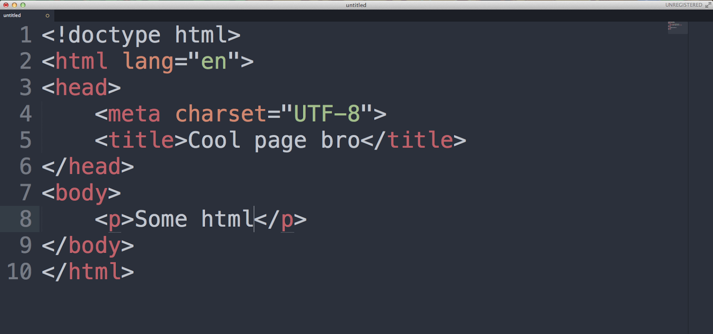
Your First Page

Slide 8
Basic HTML Page Structure
<!doctype html>
<html lang="en">
<head>
<meta charset="UTF-8">
<title>Your page name</title>
</head>
<body>
<h1>A big header</p>
<p>A paragraph of text</p>
</body>
</html>

Slide 9
!DOCTYPE
XHTML 1.0 STRICT
<!DOCTYPE html PUBLIC "-//W3C//DTD XHTML 1.0 Strict//EN" "http:
//www.w3.org/TR/xhtml1/DTD/xhtml1-strict.dtd">
XHTML 1.0 TRANSITIONAL
<!DOCTYPE html PUBLIC "-//W3C//DTD XHTML 1.0 Transitional//EN"
"http://www.w3.org/TR/xhtml1/DTD/xhtml1-transitional.dtd">
HTML 5
<!DOCTYPE html>

Slide 10
!DOCTYPE cont.
Switches the document into standards mode.
Helps the browser render the content correctly based on the rules denoted by the DOCTYPE.
Browsers will try to render your document without a doctype but it will switch into quirks mode and results may not be what you expect.

Slide 11
ANATOMY OF HTML
HTML Elements are things like img, p, a, div. img is an image element. These are the components that define the structure of your page.
HTML Tags are how you define the element. <img src=”image.jpg” /> or <p></p>
HTML Attributes are used to provide more information to your elements.
<img src=”image.jpg” />, src stands for source. This attribute lets us tell the image element what image to display.

Slide 12
The HTML Element
<!doctype html>
<html lang="en">
<head>
<meta charset="UTF-8">
<title>Document</title>
</head>
<body>
</body>
</html>

Slide 13
The HTML Element
The html element is the first element on the page, it is considered the root element, meaning the top-level element. Everything lives within the html element.
There is a lang attribute on the html element. This defines the language of the page. When using other doctypes there are other attributes that can be added.
<html xmlns="http://www.w3.org/1999/xhtml" xml:
lang="en" lang="en">

Slide 14
Head and Title Elements
<!doctype html>
<html lang="en">
<head>
<meta charset="UTF-8">
<title>Document</title>
</head>
<body>
</body>
</html>

Slide 15
Head and Title Elements cont.
The head element is used to store information for the page, what scripts are on it, the styles. The elements added in here will not be displayed on the page.
The title element is required, it defines the title of the page.
The meta element is used to provide information about the page. The charset attribute defines the character encoding for the page.

Slide 16
The Body Element
<!doctype html>
<html lang="en">
<head>
<meta charset="UTF-8">
<title>Document</title>
</head>
<body>
</body>
</html>

Slide 17
The Body Element
All your content will live in the body element.
<body>
<p>Some text</p>
<img src="cat.gif" alt="A cat gif">
<ul>
<li>List Item</li>
<li>List Item</li>
</ul>
</body>

Slide 18
REVIEW!
What is the DOCTYPE
What is the first element on the page?
How do you define HTML elements on a page?
What does the title element do?

Slide 19
Typography
<h1>Header</h1>
<h2>Sub header</h2>
<p>Some text</p>
<p>A longer sentence with some <i>italic</i> text in it.</p>
<p>This sentence has some <b>bold</b> text in it.</p>

Slide 20
Text Header Element
h1,h2,h3,h4,h5,h6 are the six levels of headers. These elements are used to denote titles.
The lower the number the higher the importance. These are important for semantic markup. It outlines a hierarchy for content.
Lets look at some examples.

Slide 21
Paragraphs, Italic and Bold
The p element is used to define a paragraph. Pretty simple.
If you want to use use HTML to bold or italicize your content you would use the i and b element. This however is usually handled using CSS, as the i element lately has be used for things like icons, more on that later.
You can also use em and strong to the same effect. em being emphasis, and strong is a strong emphasis
http://html5doctor.com/i-b-em-strong-element/

Slide 22
Lists
<ul>
<li>List Item</li>
<li>List Item</li>
<li>List Item</li>
</ul>
<ol>
<li>Ordered List Item</li>
<li>Ordered List Item</li>
<li>Ordered List Item</li>
</ol>

Slide 23
Lists cont.
There are two styles of list elements. The unordered list or ul and the ordered list ol.
A list has a child element in it call the list item, or li. Both styles of lists use the same li element.
Unordered lists are used for generic lists. By default they have a bullet for the display. Ordered lists however are used when you need to show a ranking or the list needs more structure.

Slide 24
Comments
Comments are a good thing. When working on large projects, at the time you might remember everything about what is going on. But what about a week, a month, a year from then?
<!-- comment -->
This is the syntax for a HTML comment. These elements are hidden to the user, and only visible if you few the code.

Slide 25
Links
Web pages are nothing without links. In order to link to another page, or another site, you use the a element.
<a href=”newpage.html”>Link text</a>
The key to the a element is the href attribute. The location you would like to link to goes in the href attribute.

Slide 26
Linking to pages
<!-- Link to interior page -->
<a href=”about.html”>About</a>
<a href=”blog/post.html”>Blog Post</a>
<!-- Link to external site -->
<a href=”http://ryanchristiani.com”>My Site</a>

Slide 27
Absolute and Relative links
ABSOLUTE LINKS: Uses the exact address including domain, subdirectories
and filename:
<a href="http://google.com">Google</a>
RELATIVE LINKS: Points to files located on the same server. Links to the filename and directory:
<a href="page-one.html">Page One</a>
<a href="directory/page-two.html">Page Two</a>
<a href="../page-one.html">Back to Page One</a>

Slide 28
Link Attributes
For better accessibility (ex. screen readers), include the title attribute to provide a description, visual browsers show titles as a tool tip.
To make the link open in another window use the target attribute _blank (can also use JavaScript).
<a href="http://ryanchristiani.com" title="Personal site of Ryan Christiani" target="_blank">My blog</a>

Slide 29
Email Links
Uses the mailto:email@address.com instead of URL address.
<a href="mailto:ryan@ryanchristiani.com">Say hello!</a>
Add a subject line using subject.
<a href=’mailto:ryan@ryanchristiani.com?subject=”Hi!”’>Say hello!</a>

Slide 30
DONE.

